Slide 1
ElasticSearch & Kibana (‘ELK’) on Kubernetes in Google Cloud
AutomatedITSolutions
In collaboration with
People’s Postcode Lottery and Hays IT & Digital

Slide 2



ElasticSearch & Kibana (‘ELK’) on Kubernetes in Google Cloud
Introductions
AutomatedITSolutions, People’s Postcode Lottery, Hays
John Pikoulas - john@automateditsolutions.com
Donald Simpson - don@automateditsolutions.com
Lee Varga - lee.varga@hays.com
Craig Syme - craig.syme@postcodelottery.co.uk
Scott Pringle - scott.pringle@postcodelottery.co.uk
TechStack
Partners

Slide 3
ElasticSearch & Kibana (‘ELK’) on Kubernetes in Google Cloud
Previously
In the previous session we built a Kubernetes/OpenShift Cluster on AWS using Ansible and Terraform, slides and notes are available on our website https://www.automateditsolutions.com
Today’s Presentation Summary
Create and Configure a GCP account
Create and configure a Kubernetes cluster
Configure and Deploy an ELK stack
Push test data and create charts in Kibana
TechStack
Partners

Slide 4
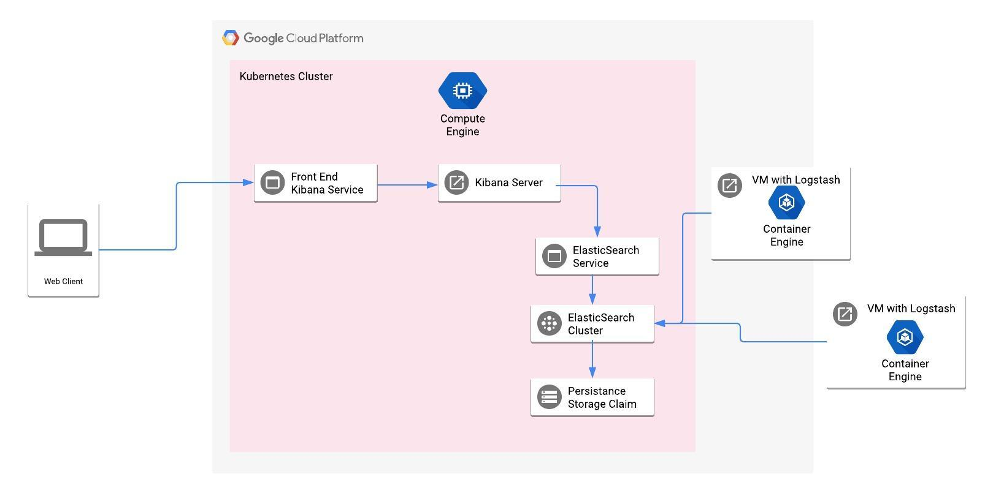
ElasticSearch & Kibana (‘ELK’) on Kubernetes in Google Cloud
Design Summary
TechStack
Partners

Slide 5
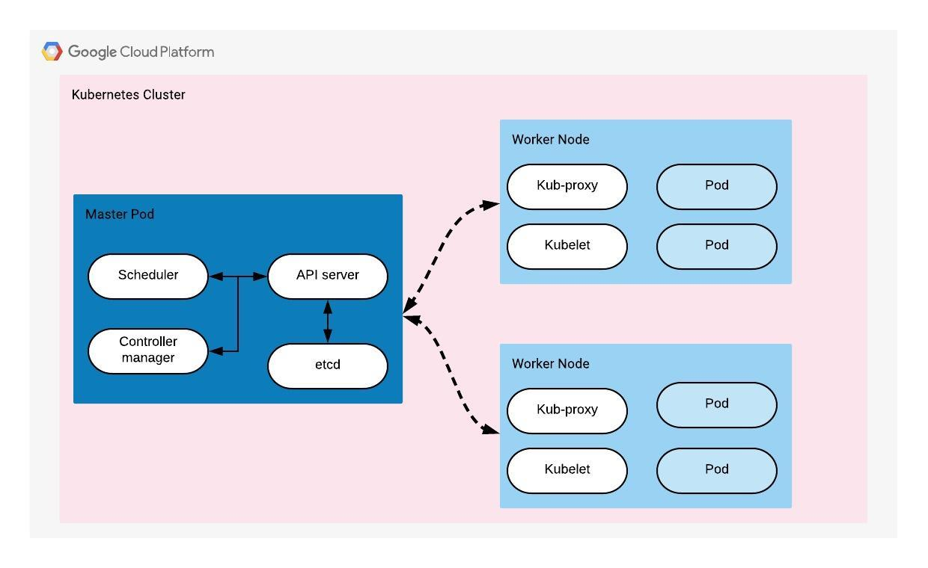
ElasticSearch & Kibana (‘ELK’) on Kubernetes in Google Cloud
Kubernetes Architecture
TechStack
Partners

Slide 6
ElasticSearch & Kibana (‘ELK’) on Kubernetes in Google Cloud
Kubernetes Architecture - Master nodes
Master nodes: the master node is the gateway for all the administrative tasks to build and manage clusters
API server: This is the interface used by the Kubernetes master control plane to receive administrative REST commands and to interact with the cluster worker nodes
Scheduler: This component typically handles pod to node allocation for newly created pods that are not yet allocated to any node, in which it selects a desirable node for them to operate
Controller manager: The Kubernetes controller manager is a daemon that embeds the core control loops shipped with Kubernetes. In Kubernetes, a controller is a control loop that watches the shared state of the cluster through the api server and makes changes attempting to move the current state towards the desired state.
Etcd: it is a CoreOS backend distributed key-value store, used by Kubernetes to store cluster’s state and configurations
TechStack
Partners

Slide 7
ElasticSearch & Kibana (‘ELK’) on Kubernetes in Google Cloud
Kubernetes Architecture - Worker nodes
One or more worker nodes: A worker node, typically it’s a machine that can be VM, Bare Metal, etc. that host and run containerized the applications using Pods, while the actual provisioning and control of these Pods on the workers’ nodes is by the master node
Kubelet: The kubelet is an agent that runs on each worker node and communicates with the master node
Container Runtime: This is the engine that used by the worker node to run and manage a container’s lifecycle
kube-proxy: In a high level, kube-proxy is the gateway of worker node to interact with the external networks and nodes as well as it enables Kubernetes to achieve service abstraction by creating and maintaining network rules on the host and performing connection forwarding, which ultimately will enable the communication to directed to the service abstraction (logical construct called a Service) rather than connecting directly to the Pod to access an application.
Pod: A Pod is an Atomic deployment and execution in Kubernetes architecture, Pod is tightly coupled to the worker node, and technically a Pod in worker can run one or more containers
TechStack
Partners

Slide 8
ElasticSearch & Kibana (‘ELK’) on Kubernetes in Google Cloud
“The ELK Stack”
- ElasticSearch, Logstash & Kibana
TechStack
Partners

Slide 9
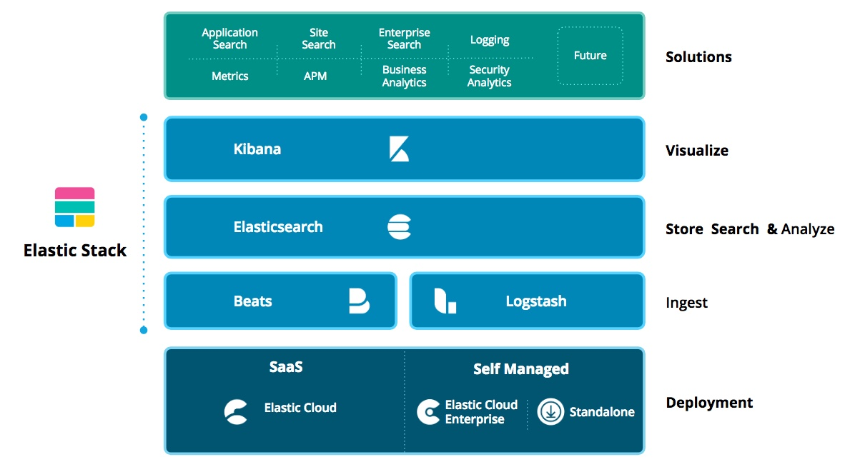
ElasticSearch & Kibana (‘ELK’) on Kubernetes in Google Cloud
ElasticSearch
TechStack
Partners

Slide 10
ElasticSearch & Kibana (‘ELK’) on Kubernetes in Google Cloud
ElasticSearch
"Elasticsearch is an open-source, broadly-distributable, readily-scalable, enterprise-grade search engine. Accessible through an extensive and elaborate API, Elasticsearch can power extremely fast searches that support your data discovery applications.”
TechStack
Partners

Slide 11
ElasticSearch & Kibana (‘ELK’) on Kubernetes in Google Cloud
ElasticSearch
Where Elasticsearch Shines
Queries: This is what you think of when you type into a search bar.
Filters: Filters are much faster than queries because there’s no ambiguity around scoring. There’s a binary yes/no decision on whether a particular document has the term
Clusters and Nodes
Clusters are a collection of nodes that communicate with each other to read and write to an index.
A node is a single instance of Elasticsearch. It usually runs one instance per machine.
Horizontal Scaling: Because the Elasticsearch cluster is not limited to a single machine, you can infinitely scale your system to handle higher traffic and larger data sets
Shards and Indices
Shards are individual instances of a Lucene index. Lucene is the underlying technology that Elasticsearch uses for extremely fast data retrieval.
Each index is comprised of shards across one or many nodes.
JSON REST API: You can interact with the Elasticsearch API and know what information is being returned. There is a collection of _cat commands that tells you about the current status of your cluster
TechStack
Partners

Slide 12
ElasticSearch & Kibana (‘ELK’) on Kubernetes in Google Cloud
Logstash
Centralize, Transform & Stash Your Data
Logstash is an open source, server-side data processing pipeline that ingests data from a multitude of sources simultaneously, transforms it, and then sends it to your favorite “stash.”
INPUTS
Ingest Data of All Shapes, Sizes, and Sources
Data is often scattered or siloed across many systems in many formats. Logstash supports a variety of inputs that pull in events from a multitude of common sources, all at the same time. Easily ingest from your logs, metrics, web applications, data stores, and various AWS services, all in continuous, streaming fashion.
FILTERS
Parse & Transform Your Data On the Fly
As data travels from source to store, Logstash filters parse each event, identify named fields to build structure, and transform them to converge on a common format for easier, accelerated analysis and business value.
OUTPUTS
Choose Your Stash, Transport Your Data
While Elasticsearch is our go-to output that opens up a world of search and analytics possibilities, it’s not the only one available.
[ see https://www.elastic.co/products/logstash ]
TechStack
Partners

Slide 13
ElasticSearch & Kibana (‘ELK’) on Kubernetes in Google Cloud
Logstash or FluentD - pros & cons…
Logstash lacks a persistent internal message queue: Currently, Logstash has an on-memory queue that holds 20 events (fixed size) and relies on an external queue like Redis for persistence across restarts. This is a known issue for Logstash, and it is actively worked on this issue where they aim to persist the queue on-disk.
Fluentd, on the other hand, has a highly configurable buffering system. It can be either in-memory or on-disk with more parameters that you ever care to know.
The upside of Logstash’s approach is simplicity: the mental model for its sized queue is very simple. However, you must deploy Redis alongside Logstash for improved reliability in production. Fluentd has built-in reliability, but its configuration parameters take some getting used to.
Logstash: Needs to be deployed with Redis to ensure reliability Fluentd: Built-in reliability, but its configuration is more complicated
TechStack
Partners

Slide 14

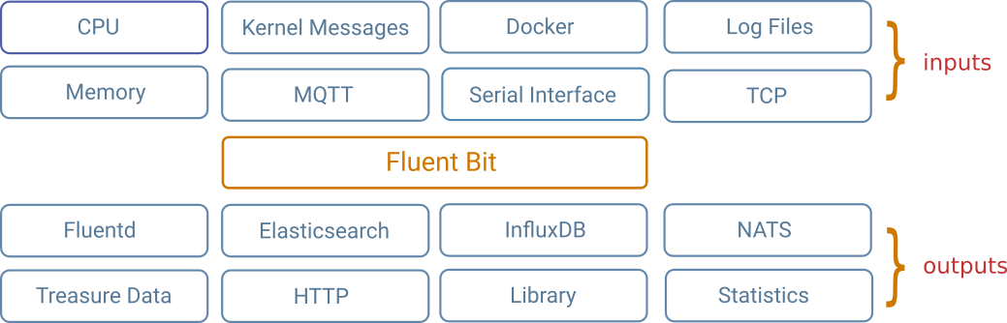
ElasticSearch & Kibana (‘ELK’) on Kubernetes in Google Cloud
Fluent Bit is an open source and multi-platform Log Processor and Forwarder which allows you to collect data/logs from different sources, unify and send them to multiple destinations. It's fully compatible with Docker and Kubernetes environments.
TechStack
Partners

Slide 15
ElasticSearch & Kibana (‘ELK’) on Kubernetes in Google Cloud
Kibana (and Canvas)
Kibana: lets you visualise your Elasticsearch data and navigate the Elastic Stack, so you can do anything from learning why you're getting paged at 2:00 a.m. to understanding the impact rain might have on your quarterly numbers.
Canvas: Go beyond the grid. Infuse your style into the story of your data with the logos, colours, and design elements that make your brand unique. Canvas is where you can get creative with your live data — and it supports SQL
TechStack
Partners

Slide 16
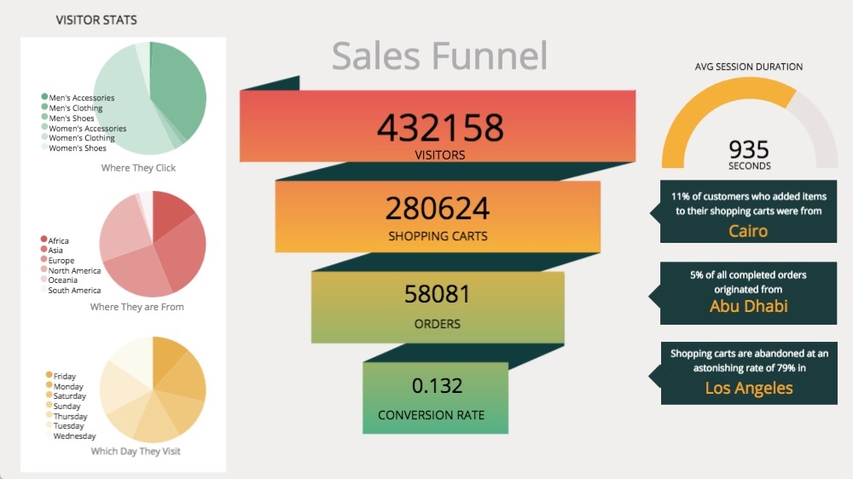
ElasticSearch & Kibana (‘ELK’) on Kubernetes in Google Cloud
Canvas
This functionality is in beta and is subject to change. The design and code is less mature than official GA features and is being provided as-is with no warranties. Beta features are not subject to the support SLA of official GA features.
Your best bet to getting started with Canvas is to check out one (or all) of the sample data sets that ship with Kibana.
TechStack
Partners

Slide 17

ElasticSearch & Kibana (‘ELK’) on Kubernetes in Google Cloud
PIZZA BREAK
TechStack
Partners

Slide 18
ElasticSearch & Kibana (‘ELK’) on Kubernetes in Google Cloud
Create a Project
TechStack
Partners

Slide 19
ElasticSearch & Kibana (‘ELK’) on Kubernetes in Google Cloud
Configure Google Cloud Platform
Update YUM with Cloud SDK repo information
sudo tee -a /etc/yum.repos.d/google-cloud-sdk.repo << EOM
[google-cloud-sdk]
name=Google Cloud SDK
baseurl=https://packages.cloud.google.com/yum/repos/cloud-sdk-el7-x86_64
enabled=1
gpgcheck=1
repo_gpgcheck=1
gpgkey=https://packages.cloud.google.com/yum/doc/yum-key.gpg
https://packages.cloud.google.com/yum/doc/rpm-package-key.gpg
EOM
Install the Cloud SDK
yum install google-cloud-sdk
yum install kubectl
TechStack
Partners

Slide 20
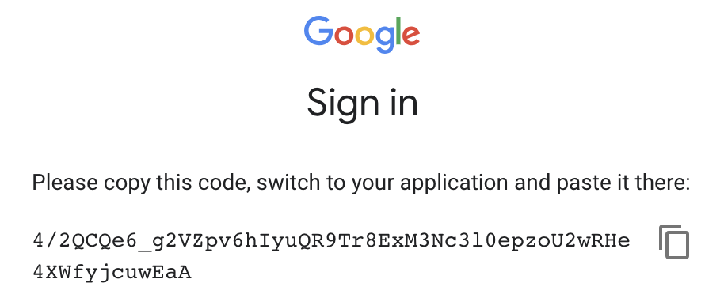
ElasticSearch & Kibana (‘ELK’) on Kubernetes in Google Cloud
Configure Google Cloud Platform
Configure GCP
gcloud init
You must log in to continue. Would you like to log in (Y/n)? y
Go to the following link in your browser:
https://accounts.google.com/o/oauth2/auth?redirect_uri=urn%3Aietf%3Awg%3Aoauth%3A2.0%3Aoob&prompt=select_account&response_type=code&client_id=32550000559.apps.googleusercontent.com&scope=https%3A%2F%2Fwww.googleapis.com%2Fauth%2Fuserinfo.email+https%3A%2F%2Fwww.googleapis.com%2Fauth%2Fcloud-platform+https%3A%2F%2Fwww.googleapis.com%2Fauth%2Fappengine.admin+https%3A%2F%2Fwww.googleapis.com%2Fauth%2Fcompute+https%3A%2F%2Fwww.googleapis.com%2Fauth%2Faccounts.reauth&access_type=offline
Copy the code to cli to verify
TechStack
Partners

Slide 21
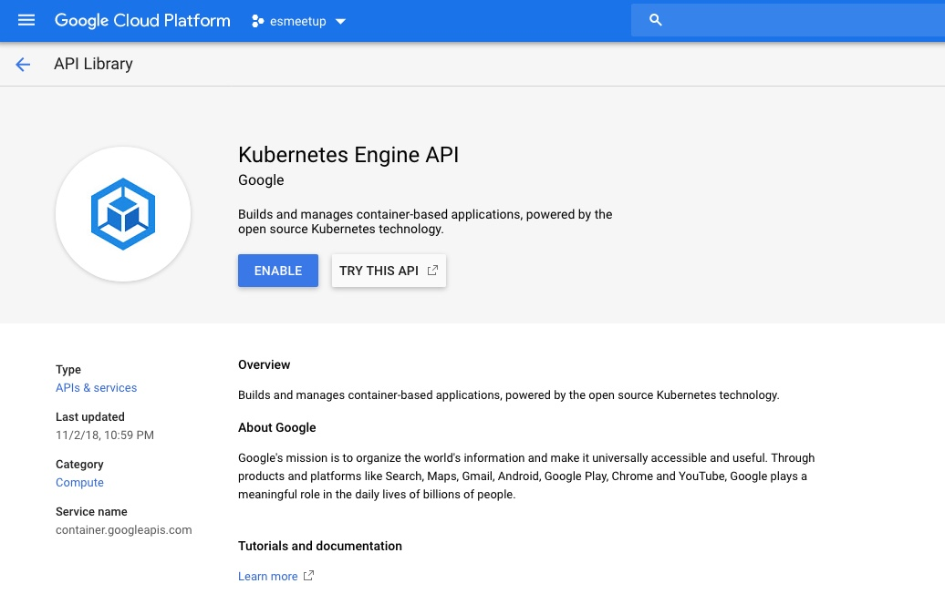
ElasticSearch & Kibana (‘ELK’) on Kubernetes in Google Cloud
Enable Kubernetes API
Create a K8s cluster
export CLUSTER=elk-stack-ppl-jan-2019
export ZONE=europe-west2
gcloud container clusters create "$CLUSTER" --zone "$ZONE" --num-nodes=2 --enable-autoscaling --min-nodes 1 --max-nodes 20 --machine-type=n1-standard-4
TechStack
Partners

Slide 22
ElasticSearch & Kibana (‘ELK’) on Kubernetes in Google Cloud
Deploy ELK stack on the k8s cluster
Install the Application resource definition
kubectl apply -f "https://raw.githubusercontent.com/GoogleCloudPlatform/marketplace-k8s-app-tools/master/crd/app-crd.yaml"
Configure the container images
TAG=6.3
export IMAGE_ELASTICSEARCH="marketplace.gcr.io/google/elastic-gke-logging:${TAG}"
export IMAGE_KIBANA="marketplace.gcr.io/google/elastic-gke-logging/kibana:${TAG}"
export IMAGE_FLUENTD="marketplace.gcr.io/google/elastic-gke-logging/fluentd:${TAG}"
export IMAGE_INIT=“marketplace.gcr.io/google/elasticsearch/ubuntu16_04:${TAG}”
Scripts used from this site https://github.com/GoogleCloudPlatform/click-to-deploy/tree/master/k8s/elastic-gke-logging
TechStack
Partners

Slide 23
ElasticSearch & Kibana (‘ELK’) on Kubernetes in Google Cloud
Deploy ELK stack on the k8s cluster
Setup gcloud as a Docker credential helper
gcloud auth configure-docker
Get the digest for the image
for i in IMAGE_ELASTICSEARCH IMAGE_KIBANA IMAGE_FLUENTD IMAGE_INIT; do
repo=$(echo ${!i} | cut -d: -f1);
digest=$(docker pull ${!i} | sed -n -e 's/Digest: //p');
export $i="$repo@$digest";
env | grep $i;
done
Expand the manifest template - Use envsubst to expand the template
awk 'FNR==1 {print "---"}{print}' manifest/* \
| envsubst '$APP_INSTANCE_NAME $NAMESPACE \
$IMAGE_ELASTICSEARCH $IMAGE_KIBANA $IMAGE_FLUENTD $IMAGE_INIT $ELASTICSEARCH_REPLICAS' \
> "${APP_INSTANCE_NAME}_manifest.yaml"
Create namespace - vi 00-namespace.yml
apiVersion: v1
kind: Namespace
metadata:
name: automateditsolutions-dev
labels:
env: dev
kubectl create -f 00-namespace.yml
TechStack
Partners

Slide 24
ElasticSearch & Kibana (‘ELK’) on Kubernetes in Google Cloud
Apply the manifest to your Kubernetes cluster
kubectl apply -f "${APP_INSTANCE_NAME}_manifest.yaml" --namespace "${NAMESPACE}"
Deploy ELK stack on the k8s cluster
Make the Elasticsearch and Kibana services externally available
kubectl patch svc "$APP_INSTANCE_NAME-elasticsearch-svc" --namespace "$NAMESPACE" --patch '{"spec": {“type”: “LoadBalancer"}}'
kubectl patch svc "$APP_INSTANCE_NAME-kibana-svc" --namespace "$NAMESPACE" --patch '{"spec": {"type": "LoadBalancer"}}'
TechStack
Partners

Slide 25
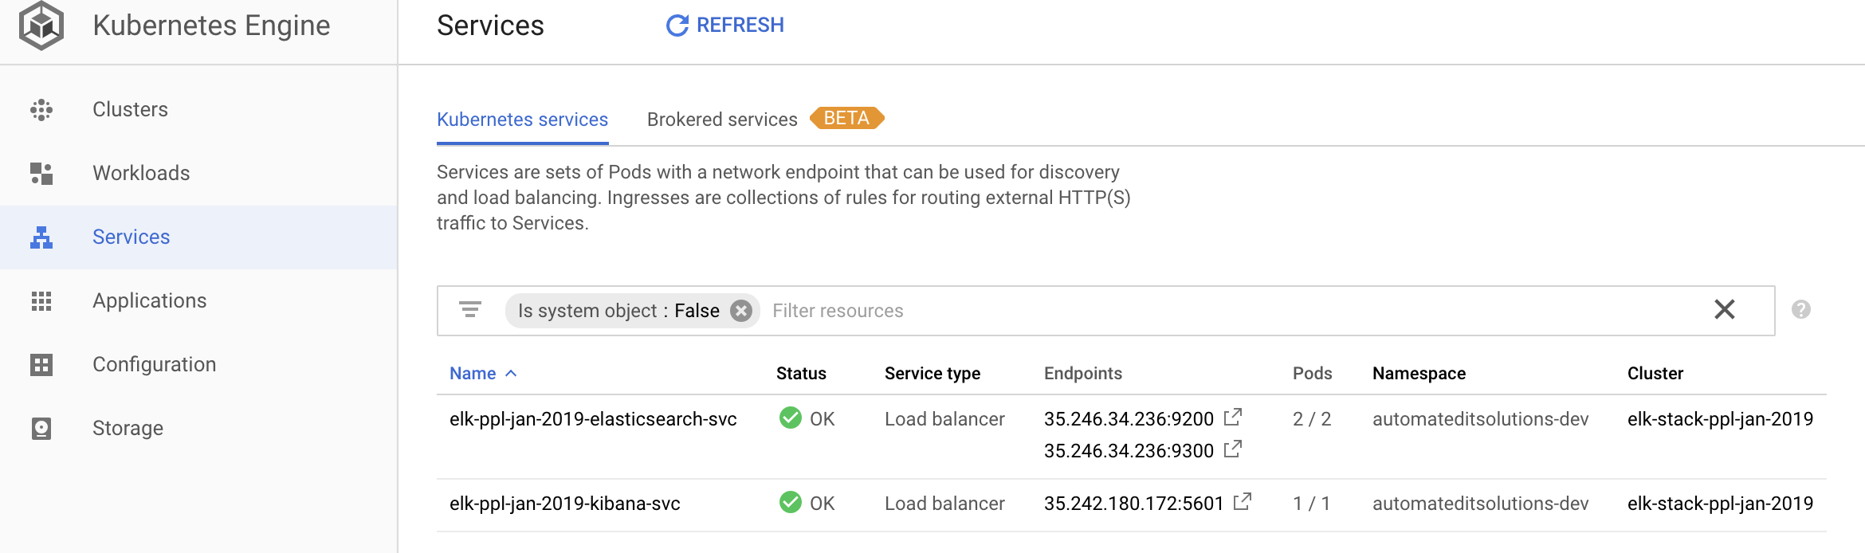
ElasticSearch & Kibana (‘ELK’) on Kubernetes in Google Cloud
Deploy ELK stack on the k8s cluster
Make the Elasticsearch and Kibana services externally available
TechStack
Partners

Slide 26
ElasticSearch & Kibana (‘ELK’) on Kubernetes in Google Cloud
Logstash, MetricBeat and Canvas
Installing Logstash
rpm --import https://artifacts.elastic.co/GPG-KEY-elasticsearch
Add the following in your /etc/yum.repos.d/ directory in a file with a .repo suffix, for example logstash.repo
[logstash-6.x]
name=Elastic repository for 6.x packages
baseurl=https://artifacts.elastic.co/packages/6.x/yum
gpgcheck=1
gpgkey=https://artifacts.elastic.co/GPG-KEY-elasticsearch
enabled=1
autorefresh=1
type=rpm-md
vi /etc/logstash/conf.d/logstash.conf
input {
file {
path => "/var/log/messages"
start_position => "beginning"
}
}
output {
elasticsearch {
hosts => ["http://35.189.113.137:9200"]
#user => "elastic"
#password => "changeme"
index => "ppl_test"
}
}
TechStack
Partners

Slide 27
ElasticSearch & Kibana (‘ELK’) on Kubernetes in Google Cloud
Logstash, MetricBeat and Canvas
Configure log stash
vi /etc/logstash/conf.d/logstash.conf
input {
file {
path => "/var/log/messages"
start_position => "beginning"
}
}
output {
elasticsearch {
hosts => ["http://35.189.113.137:9200"]
#user => "elastic"
#password => "changeme"
index => "ppl_test"
}
}
TechStack
Partners

Slide 28
ElasticSearch & Kibana (‘ELK’) on Kubernetes in Google Cloud
Logstash, MetricBeat and Canvas
Installing metricbeat
rpm:
curl -L -O https://artifacts.elastic.co/downloads/beats/metricbeat/metricbeat-6.5.4-x86_64.rpm
sudo rpm -vi metricbeat-6.5.4-x86_64.rpm
deb:
curl -L -O https://artifacts.elastic.co/downloads/beats/metricbeat/metricbeat-6.5.4-amd64.deb
sudo dpkg -i metricbeat-6.5.4-amd64.deb
Setup Kibana dashboards
metricbeat setup --dashboards
TechStack
Partners

Slide 29
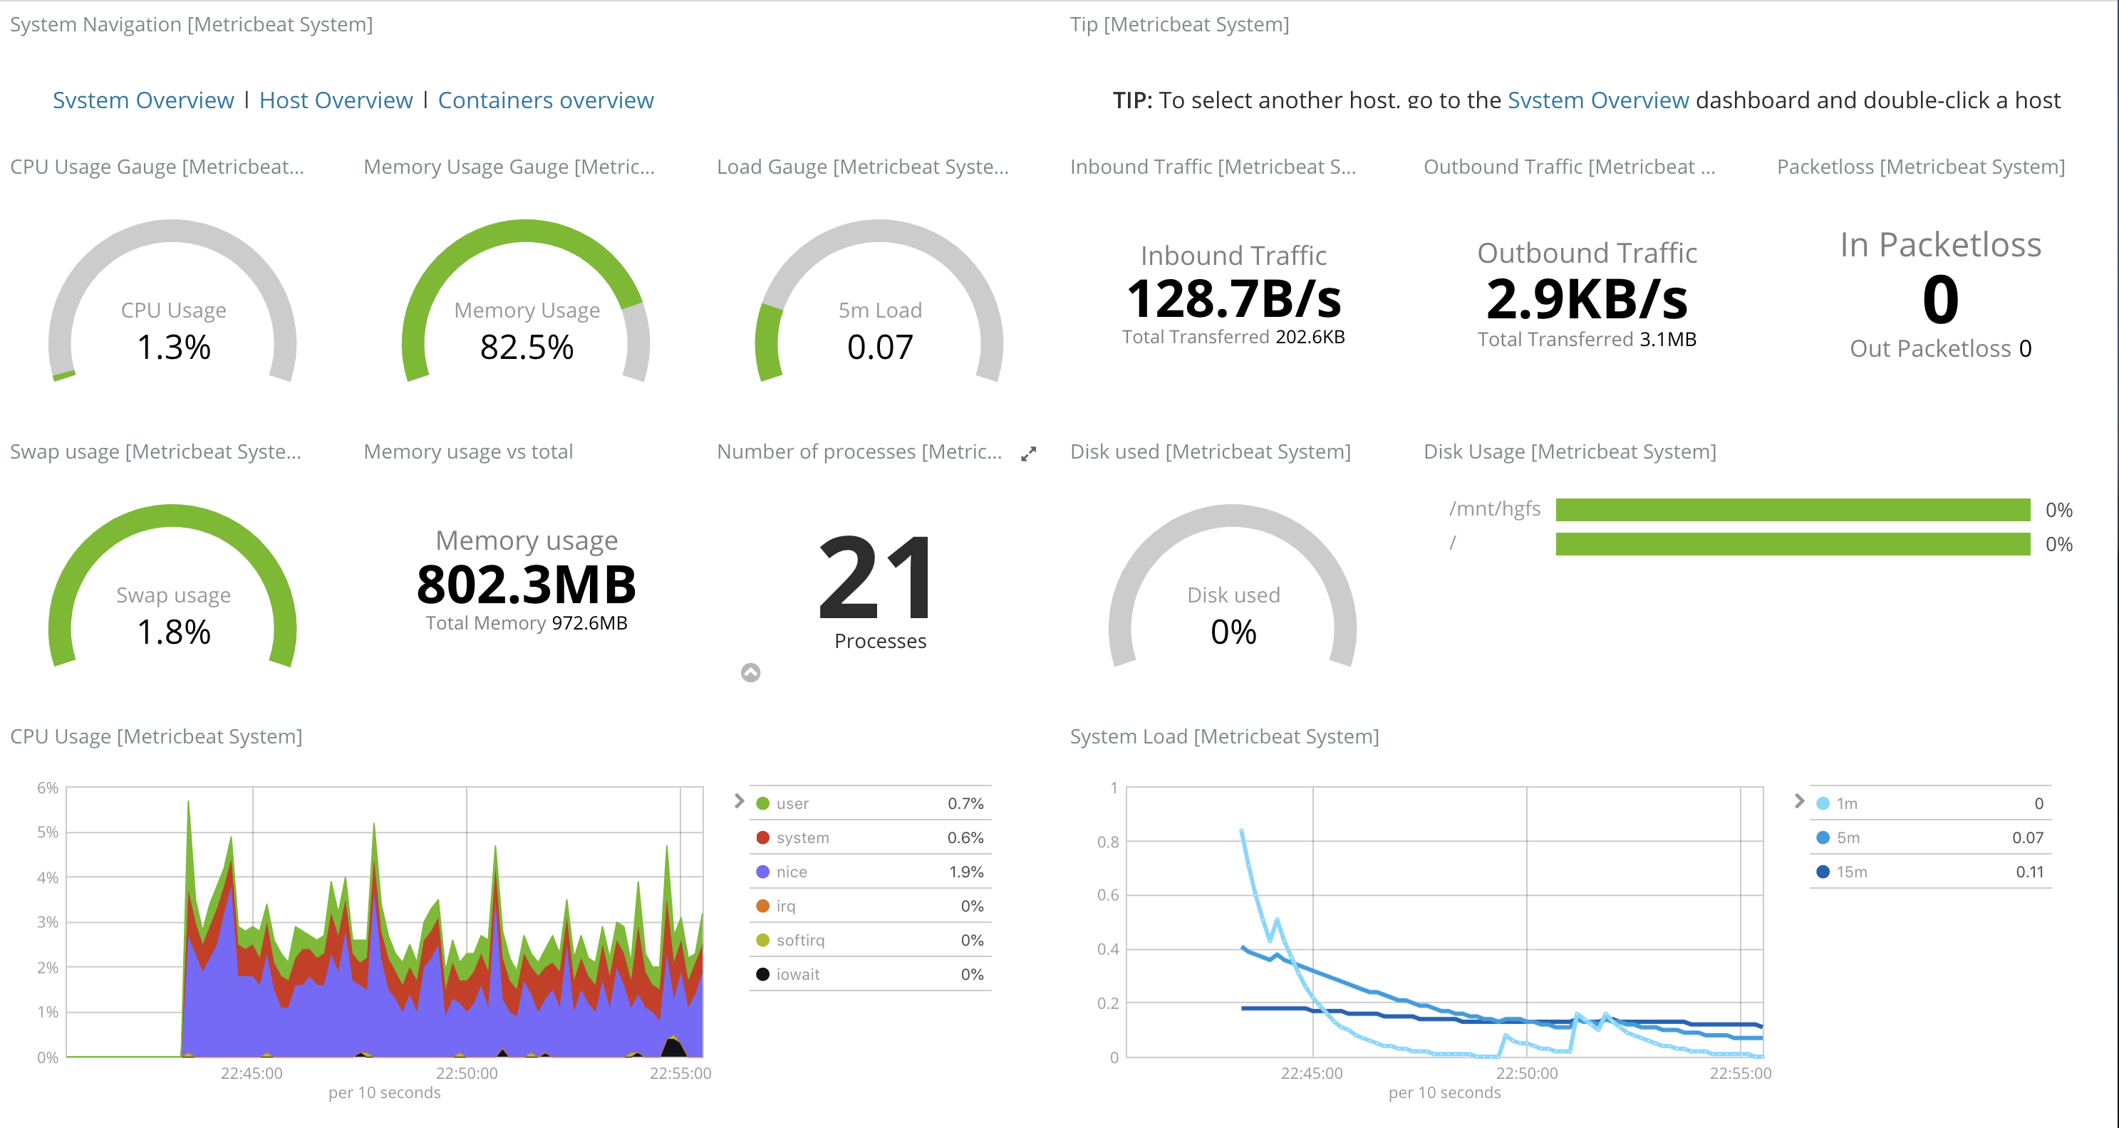
ElasticSearch & Kibana (‘ELK’) on Kubernetes in Google Cloud
Logstash, MetricBeat and Canvas
Metricbeat Dashboards
TechStack
Partners

Slide 30
ElasticSearch & Kibana (‘ELK’) on Kubernetes in Google Cloud
Logstash, MetricBeat and Canvas
Kibana - Canvas
Canvas is a presentation tool — built into Kibana — that allows users to create pixel-perfect presentations and slide decks that pull live data directly from Elasticsearch
Why use Canvas
Canvas not only removes the tedium of constantly updating visualizations in a presentation, it also gives its users powerful tools and filters to adjust data on the fly, allowing for very flexible, dynamic, and compelling presentations.
Installing Canvas
Starting in version 6.5, Canvas ships with the default distribution of Kibana. Simply install Elasticsearch and Kibana to get started with Canvas.
TechStack
Partners

Slide 31
ElasticSearch & Kibana (‘ELK’) on Kubernetes in Google Cloud
Recap and pass over to PPL ELK presentation
TechStack
Partners

Slide 32
ElasticSearch & Kibana (‘ELK’) on Kubernetes in Google Cloud
Questions and feedback
Links and resources
Plans for next talks….
TechStack
Partners

Slide 33
ElasticSearch & Kibana (‘ELK’) on Kubernetes in Google Cloud
What next?
In the following sessions we plan to go in to more detail on Kubernets, and build our own Kubernetes cluster “from scratch”
e.g. on bare metal, not using a Cloud Provider
Terraform and Ansible for host provisioning
kubeadm to build the Kubernetes cluster on top
Provision a pod network
Add persistent storage to the cluster with Rook/Ceph and look at alternatives
Set up a Kubernetes Dashboard
Setup Helm (client) and install Tiller (server) to the k8s cluster
And then?
Review Helm charts for deploying "stable" applications
Add EFK via Helm
Add monitoring with Prom and Grafana via Helm
Look at writing and configuring our own Helm Charts
Deploy a custom Blockchain/Ethereum cluster to k8s and use it in an application
- pref Ruby & Sinatra speaking to blockchain via RPC - Don is looking for any volunteers to help?
TechStack
Partners

